Slide 1

The Project Economy:
An Opportunity for Managers, Leaders and Entry Levels
Presenter: Dr. Ashraf Bocktor

Slide 2
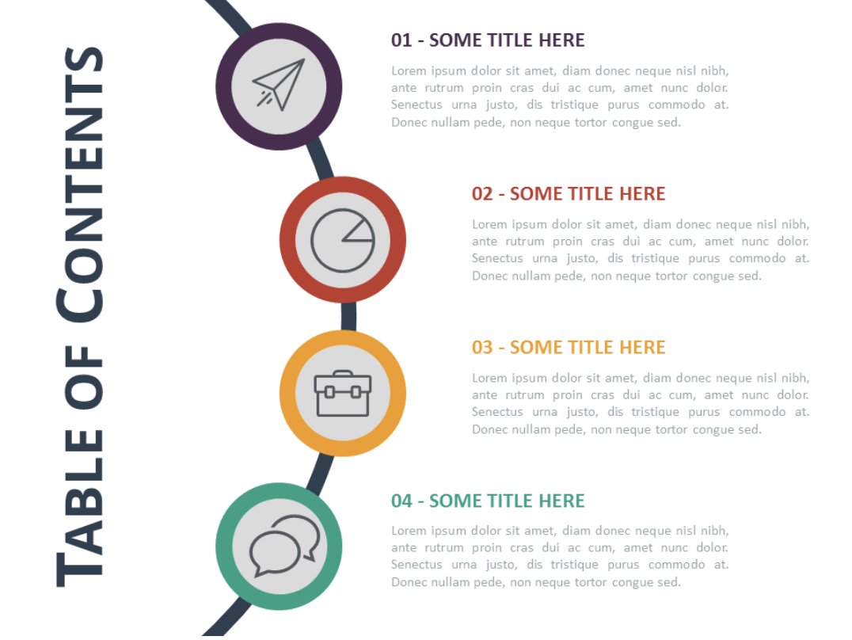

INTRODUCTION/ ICE BREAKER
PATH-HIVE Mini Contents and Description
a.Benefits
b.Price
c.Promo and Detailed Agenda
PATH-HIVE Team Dynamics Workshop
PATH-HIVE Mindset Assessment
CLOSING AND CONCLUSION
COMMENTS AND QUESTIONS

Slide 3

Ice Breaker;
an inspiring reading

Slide 4



Ice Breaker
Why did I read to you this “ice breaker”?
TRUST
PATH (People at the heart)
Change in individuals, governments, corporations and organizations
AWARENESS

Slide 5

4D
THE ALIGNMENT OF FOUR ENERGIES TO CREATE AND ACHIEVE ANYTHING
INTELLECTUAL ENERGY
(thinking and mindset)
SPIRITUAL ENERGY
(the power of words)
EMOTIONAL ENERGY
(feeling and people alignment)
PHYSICAL ENERGY
(doing dimension)

Slide 6
PATH-HIVE MINI
CONTENTS AND DESCRIPTION
PROMO AND DETAILED AGENDA
BENEFITS
PRICE

Slide 7
PATH-Hive Mini
My experience at the University of Cambridge conducting physics research, then my MBA and the University of St. Gallen in Switzerland, then Prince2, Scrum, MSP and MOR and of course practical experience led me to develop:
The building blocks to analyse problems and manage change from first principles:
What
Why
Key Success factors
Who
Very useful when there is an emergency.

Slide 8
PATH-Hive Mini
Consider a Career in Business Analysis and Business Project Management
What Questions you will try to ask/or to find out answers to at the start of a strategic initiative?
You have about 5 minutes
Example of a team exercise

Slide 9
INITIATIVE SCENARIO
Below is my answer; I mean the questions that I would ask:
What do we want to achieve?
Why/Benefits of the strategic Initiatives?
Who are the stakeholders?
Who are the project sponsors?
Who are the project beneficiaries?
Who is/will be the delivery team?
Who is/will be needed as external

Slide 10
BUILDING BLOCKS: SOLUTION/DELIVERY
Building Blocks and RACI
Duration and Effort
Selection of Vendor (criteria exercise 3)
Before we discuss the building blocks of our project, we will have another exercise based on one assumption that the software/tool/application will NOT be built in house but we need to select it from the market (vendor).

Slide 11
SELECTION OF VENDOR/SOFTWARE CRITERIA
CRITERIA | SOFTWARE 1 | SOFTWARE 2 | SOFTWARE 3
1. COST
2. PROXIMITY
3. READINESS
4. TECHNICAL CHALLENGES

Slide 12
SELECTION OF VENDOR/SOFTWARE CRITERIA
CRITERIA | SOFTWARE 1 | SOFTWARE 2 | SOFTWARE 3
1. COST | Subscription model Monthly £ Unlimited users No extra costs for installation or maintenance | One off purchase at £ Yearly maintenance fees of £ Unlimited users | Payment per user at £ per year Fixed Yearly maintenance fees at £
2.PROXIMITY | UK based provider Office in London | EU based provider No office in the UK | US based provider Small presence in London

Slide 13
ADKAR MODEL - The People Side of Change
AWARENESS
REINFORCEMENT
EMOTIONAL
DIMENSION
DESIRE
CAPABILITY

Slide 14


Slide 15
PATH-HIVE MINI
BENEFITS FOR PARTICIPANTS AND RESTART
Raise awareness of the participants of the huge potential career opportunities that they can conquer by understanding the basics of Business Change Management.
Understand yourself and where you can potentially fit.
How to start such journey with almost no front investment.

Slide 16

PATH-HIVE MINI
4. Feel good, feel optimistic.
5. Get under the belt solid tools that you can immediately use in a business project environment.
6. Improve the KPI of the centre by bringing working forace to the £50 trillion industry that is desperate for fresh (different talent). Statistics shows 15-35% rate of success of change initiatives.
https://hbr.org/2023/02/how-ai-will-transform-project-management

Slide 17

£750 - 2 hour workshop
PATH-HIVE Mini

Slide 18
PATH-HIVE Team Dynamics Workshop
Background and Description
Every team dynamics workshop offers something new.
PATH-HIVE Team Dynamics workshop aspires to produce short descriptions that define each participant that resonate with others.

Slide 19
PATH-Hive Team Dynamics Workshop
That links, individual values with organisation strategic objectives, personal skills as well as potential -based on the leadership programme of the ESADE Business School in Spain and the University of St. Gallen in Switzerland-All brought to life and tested on a corporate client and in a school environment.
C.

Slide 20
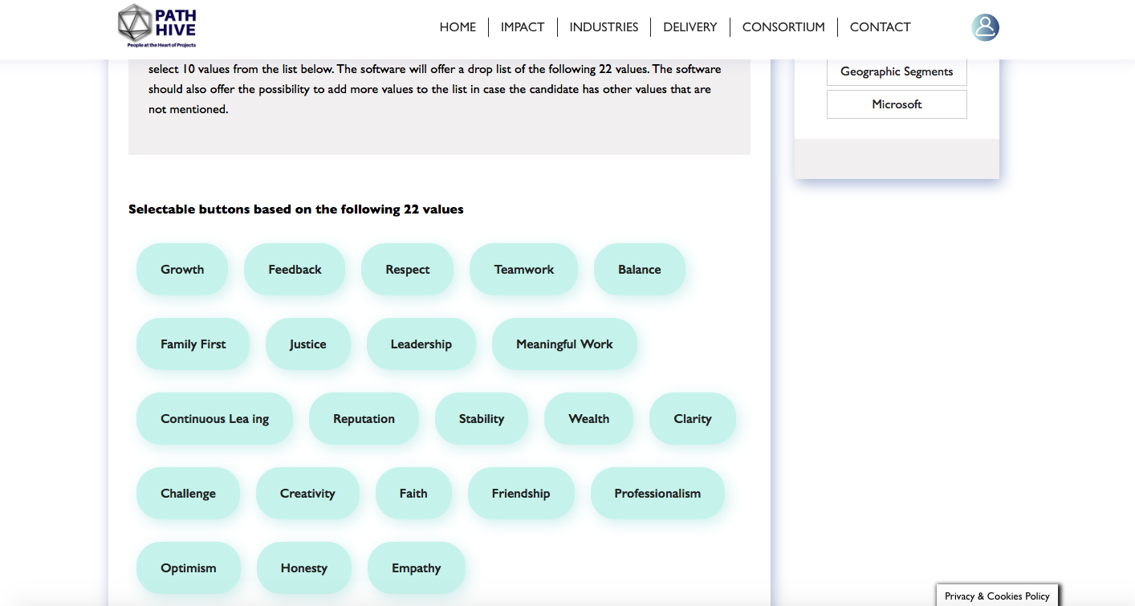
PATH-Hive Team Dynamics Workshop

Slide 21
PATH-Hive Team Dynamics Workshop
Short example
Benevolent bouncy Brooke.
Amazing aspiring Areen.
Long example
Anna is a highly intelligent person and professionalism is her most important personal value. She desires to offer value and take part of meaningful engagements that impact others around her.Anna’s such high professional character, combined with hidden empathy, grace and love to people allow her to offer very high standards new products and services and her outstanding brain power allows her to have very analytical inputs.Anna likes to learn via one-to-one communication and she prefers receiving as well as presenting information in visual form that allows for clarity and conciseness. Anna's skills and personality make her ideal for being part of, or a leader of projects that…
Anna in 5 words: wisdom, energy, grace, assurance and hope.

Slide 23
PATH-Hive Team Dynamics Workshop
A lasting resonance or at least a longer takeaway from the workshop where people will know each other for.
A potential complementary team that can handle future change.
Recognise the power of words to heal, to empower and remove the main obstacles why we do not stick with our resolutions.

Slide 24
£1500 - 2 day workshop
PATH-HIVE Team Dynamics

Slide 25
PATH MINDSET ASSESSMENT
Contents
Introduction to the concept of Positive Intelligence.
Modern mindset Leadership for change assessment.

Slide 27
PATH-Hive Mindset Assessment
Helps the leaders and managers to understand the most powerful type of intelligence that helps us to achieve our full potential.
Instill such mind set in the participants of the restart programme.
Make the leaders aware of the must have 7 mindset needed to lead change and be ready for the project economy.

Slide 28
PATH-Hive Mindset Assessment
4. Assess which of these mindsets is/are missing that you can chose to follow the leadership programme of modern mindset leadership.
5. Improve your KPI’s.
6. Surprise your board members why you are really better than the rest of organizations offering the same services.
7. See yourself a modern leader who goes beyond charisma or eloquence speech.

Slide 29
£1000 - 2 hours workshop
PATH-HIVE Mindset Assessment

Slide 30
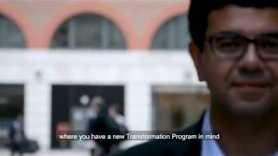
CLOSING AND CONCLUSION
The doing dimension that we all focus upon is just the result of (or in other words must be in association with) the right thinking, the emotional people alignment and the positive constructive values and words.
Let’s dream together that from this room we will be the reason to prepare the whole of the UK to the Project Economy and capitalize on such opportunity for leaders, managers and job seekers.
Notes:
I expect in our first meeting a question and now I also expect another question.

